Slide 1
DSO510 Project 2
Cheng CHEN, Cheng ZHANG, Jie CHEN,
Mi ZHONG, Xinyu LIANG, Yang LU, Yinghan LIU

Slide 2
Goal Definition
Analyze the relationship between gross box office of a movie and other independent variables including genre, budget, popularity of director and cast, etc., in order to:
guide film producers/investors on how to make high-quality movies, and
help movie theaters predict which movies will generate higher box office

Slide 3
Variables
Gross Box Office | Duration Country MPAA Rating Director FB Likes Cast Total Facebook Likes Genre | Budget Num critics for reviews IMDB Score Summer/Christmas Release (Day, Month, Year) Gross/Budget Actor1/Cast Total FB Likes
IMDB | Duration Country MPAA Rating Director FB Likes Cast Total Facebook Likes Genre | Budget Num critics for reviews Total FB Likes of Actor 1, 2, 3 Gross/Budget

Slide 4
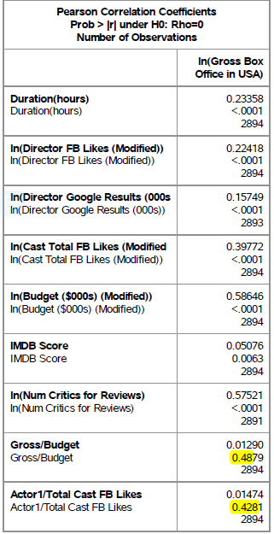
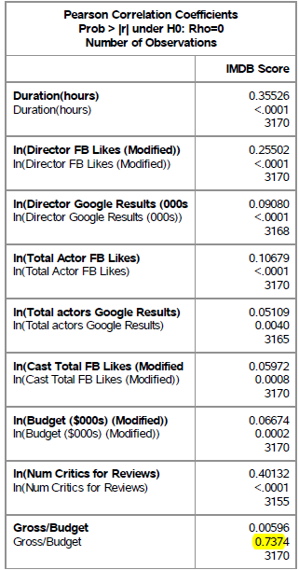
correlation
In model Gross Box office, the p-value of Gross/Budget and Actor 1/ Total cast FB likes are larger than 0.05.
In model IMDB score, the p-value of Gross/Budget is larger than 0.05.
Positive Association
Notes:
P-value
Positive association

Slide 5
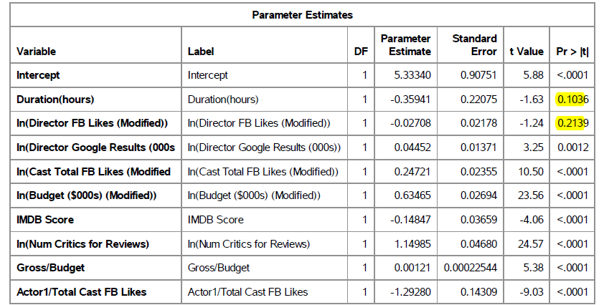
Gross Box Office Model

Slide 6
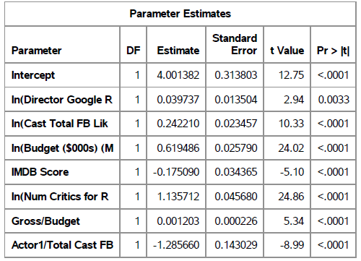
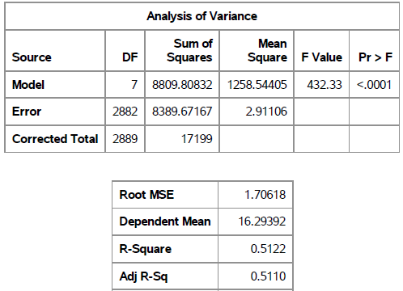
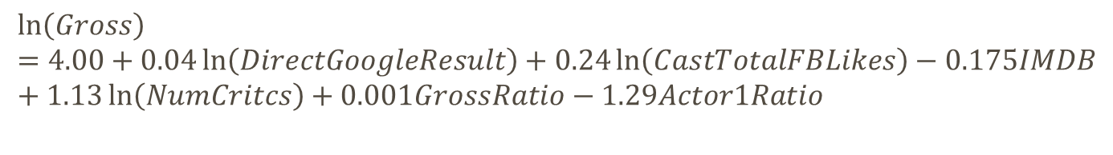
Gross Box Office model - stepwise
$$\ln\left(Gross\right)=4.00+0.04\ln\left(DirectGoogleResult\right)+0.24\ln\left(CastTotalFBLikes\right)−0.175IMDB+1.13\ln\left(NumCritcs\right)+0.001GrossRatio−1.29Actor1Ratio$$
Notes:
regression models in which the choice of predictive variables is carried out by an automatic procedure.

Slide 7
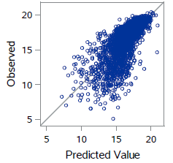
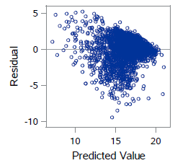
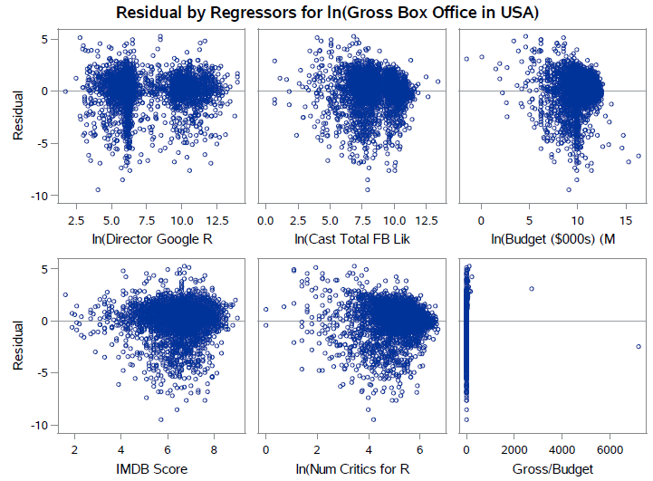
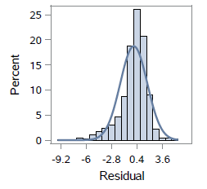
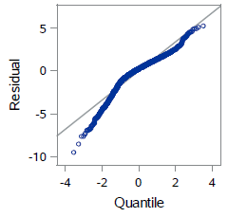
Gross Box Office model - Graphs

Slide 8
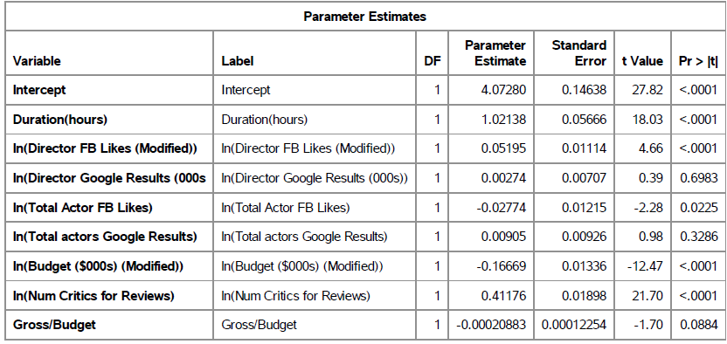
IMDB

Slide 9
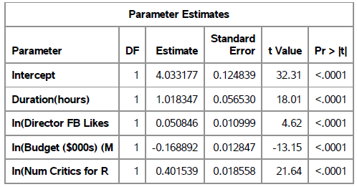
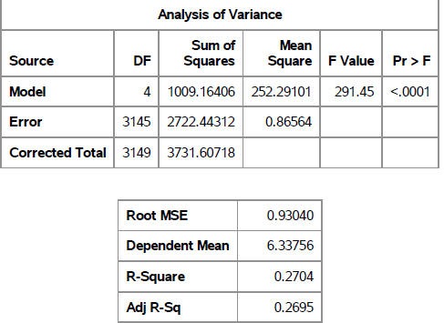
Imdb model - stepwise
$$IMDB=4.03+1.01Durations+0.05\ln\left(DirectFBLikes\right)−0.17\ln\left(Budget\right)−0.40\ln\left(NumCritics\right)$$

Slide 10
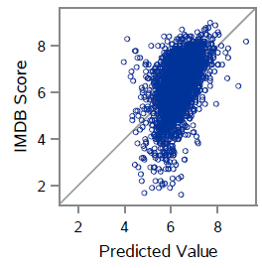
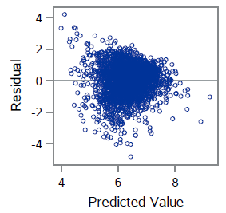
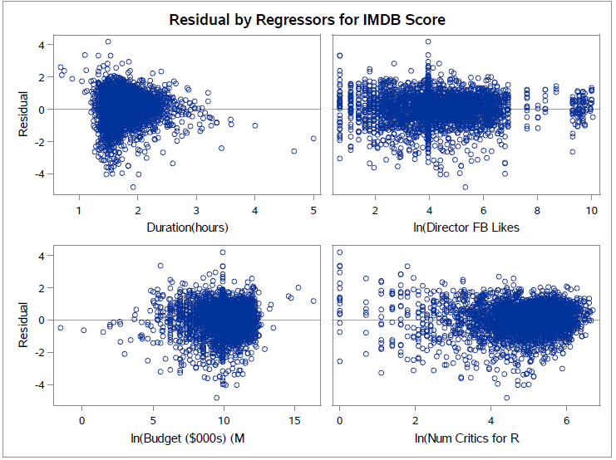
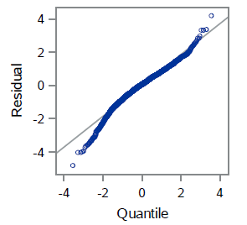
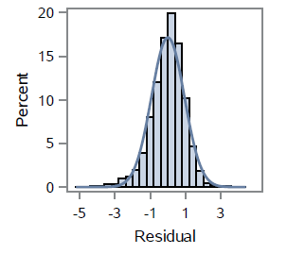
Imdb model – graphs

Slide 11
Categorical Variables & Levels
Class | Levels | Values
MPAA Rating | 6 | G, PG, PG-13, R, NC-17, NA
Continent | 6 | Africa, Asia, Europe, North America, Oceania, South America
Release Time | 3 | Summer (May – Aug.), Christmas (Dec. – Jan.), Other
Genre Category | 5 | Action, Documentary, Fantasy, Happy Hour, Tension
Action | Documentary | Fantasy | Happy Hour | Tension
Adventure Action | News Documentary History War Biography | Sci-Fi Fantasy | Family Comedy Sport Romance Music/Musical Animation | Thriller Horror Crime Mystery

Slide 12
Which continent produces movies with the lowest IMDB score?
North America…
Which continent produces movies that generate the highest gross box office in US?
…North America!
Overall,
IMDB Score: South America > Asia > Oceania > Europe > North America
Gross Box Office: North America > Europe > Asia
Notes:
* More observations of North American movies, quality vary
* Less obs of movies of other countries; movies included in IMDB database are classic/high quality

Slide 13
ANOVA: Continent, Genre & IMDB Score
Genre Category | Continent | Genre Category | Continent | Estimate | Pr > |t|
Tension | North America | Tension | South America | -1.9696 | 0.0002
Tension | Oceania | Tension | South America | -2.0393 | 0.0008
Tension | Europe | Tension | South America | -1.5324 | 0.0045
Happy Hour | Asia | Happy Hour | North America | 0.4292 | 0.0096
Action | Asia | Action | North America | 0.4024 | 0.0133
Tension | Asia | Tension | South America | -1.4298 | 0.0144
Tension | Africa | Tension | North America | 1.7446 | 0.0214
Tension | Asia | Tension | North America | 0.5398 | 0.0223
Tension | Africa | Tension | Oceania | 1.8143 | 0.025
Happy Hour | North America | Happy Hour | Oceania | -0.5791 | 0.0315
Fantasy | Asia | Fantasy | North America | 0.579 | 0.0331
Action | North America | Action | Oceania | -0.5556 | 0.0344
Fixed Genre
Fixed Genre:
Action : Oceania > Asia > North America
Fantasy : Asia > North America
Happy Hour : Oceania > Asia > North America
Tension : Africa > South America > Asia > Europe > North America > Oceania
Model Pr > F: <.0001; R-Square = 0.0612
13

Slide 14
ANOVA: Continent, MPAA Rating & IMDB Score
MPAA Rating | Continent | MPAA Rating | Continent | Estimate | Pr > |t|
PG-13 | Asia | PG-13 | North America | 0.5786 | 0.0104
PG-13 | Europe | PG-13 | North America | 0.5238 | <.0001
PG-13 | North America | PG-13 | Oceania | -0.9284 | 0.0019
R | Asia | R | North America | 0.5243 | 0.0056
R | Asia | R | South America | -0.9212 | 0.0386
R | Europe | R | North America | 0.3252 | <.0001
R | Europe | R | South America | -1.1203 | 0.0062
R | North America | R | South America | -1.4455 | 0.0004
R | Oceania | R | South America | -1.43 | 0.0024
Fixed Rating
Fixed MPAA Rating:
PG-13: Oceania > Asia > Europe > North America
R: South America > Asia > Europe > Oceania > North America
Model Pr > F: <.0001; R-Square = 0.0478
Notes:
Differences of MPAA Rating*Continent Least Squares Means Adjustment for Multiple Comparisons: Tukey-Kramer

Slide 15
ANOVA: Continent, Genre & Gross Box Office
Continent | Genre Category | Continent | Genre Category | Estimate | Pr > |t|
Asia | Action | Europe | Action | -33717 | 0.0067
Asia | Action | North America | Action | -79534 | <.0001
Asia | Action | Oceania | Action | -79536 | 0.0002
Europe | Action | Oceania | Action | -45818 | 0.0156
Europe | Action | North America | Action | -45816 | <.0001
Asia | Documentary | North America | Documentary | -34443 | 0.0368
Europe | Documentary | North America | Documentary | -21861 | 0.0089
Asia | Fantasy | North America | Fantasy | -84439 | <.0001
Asia | Fantasy | Oceania | Fantasy | -106953 | 0.0003
Europe | Fantasy | Oceania | Fantasy | -72887 | 0.0032
Europe | Fantasy | North America | Fantasy | -50373 | <.0001
Asia | Happy Hour | North America | Happy Hour | -33369 | 0.0037
Europe | Happy Hour | North America | Happy Hour | -25179 | <.0001
Europe | Tension | North America | Tension | -18335 | 0.0004
Fixed Genre
Fixed Genre:
Action: North America > Oceania > Europe > Asia
Documentary: North America > Europe > Asia
Fantasy: Oceania > North America > Europe > Asia
Happy Hour: North America > Europe > Asia
Tension: North America > Europe
Model Pr > F: <.0001; R-Square = 0.1023

Slide 16
ANOVA: Continent, MPAA Rating & Box Office
Continent | MPAA Rating | Continent | MPAA Rating | Estimate | Pr > |t|
Africa | G | North America | G | -104349 | 0.0453
Asia | G | North America | G | -89267 | 0.0369
Europe | G | North America | G | -75720 | <.0001
Africa | PG | North America | PG | -84931 | 0.0443
Asia | PG | Europe | PG | -39476 | 0.0159
Asia | PG | North America | PG | -60091 | <.0001
Europe | PG | North America | PG | -20615 | 0.0049
Asia | PG-13 | Europe | PG-13 | -27295 | 0.0391
Asia | PG-13 | North America | PG-13 | -60073 | <.0001
Asia | PG-13 | Oceania | PG-13 | -86172 | <.0001
Europe | PG-13 | North America | PG-13 | -32778 | <.0001
Europe | PG-13 | Oceania | PG-13 | -58878 | 0.0007
Asia | R | North America | R | -26621 | 0.0074
Europe | R | North America | R | -17382 | <.0001
Fixed Rating
Fixed MPAA Rating:
G: North America > Asia > Europe
PG: North America > Europe > Asia
PG-13: North America > Oceania > Europe
R: North America > Europe > Asia
Model Pr > F: <.0001; R-Square = 0.1307

Slide 17
Movies of which genre have the highest/lowest IMDB score?
Documentary/Fantasy!
Movies of which genre have the highest/lowest gross box office in US?
Fantasy/documentary…
Overall,
IMDB Score: Documentary > Action > Tension > Happy Hour > Fantasy
Gross Box Office: Fantasy > Action > Happy Hour > Tension > Documentary
Notes:
Documentary – narrow audience base, focus on recording & storytelling; but inspiring
Fantasy – fascinating visual effect, super stars

Slide 18
ANOVA: Genre, Continent & IMDB Score
Genre Category | Continent | Genre Category | Continent | Estimate | Pr > |t|
Documentary | Europe | Happy Hour | Europe | 0.4374 | 0.0003
Documentary | Oceania | Tension | Oceania | 1.2043 | 0.0066
Action | Europe | Happy Hour | Europe | -0.2744 | 0.0118
Documentary | Asia | Happy Hour | Asia | 0.6641 | 0.018
Happy Hour | Africa | Tension | Africa | -2.2333 | 0.0223
Action | Asia | Documentary | Asia | -0.6281 | 0.0237
Action | Europe | Tension | Europe | -0.2253 | 0.038
Fixed Continent
Fixed Continent:
Africa: Tension > Happy Hour
Asia: Documentary > Action > Happy Hour
Europe: Documentary > Tension > Action > Happy Hour
Oceania: Documentary > Tension
Model Pr > F: <.0001; R-Square = 0.0612

Slide 19
ANOVA: Genre, Continent & Gross Box Office
Continent | Genre Category | Continent | Genre Category | Estimate | Pr > |t|
Europe | Action | Europe | Documentary | 28797 | 0.0016
Europe | Action | Europe | Happy Hour | 19450 | 0.0099
Europe | Action | Europe | Tension | 17395 | 0.0208
Europe | Documentary | Europe | Fantasy | -30755 | 0.003
Europe | Fantasy | Europe | Tension | 19353 | 0.0317
North America | Action | North America | Documentary | 52753 | <.0001
North America | Action | North America | Happy Hour | 40088 | <.0001
North America | Action | North America | Tension | 44877 | <.0001
North America | Documentary | North America | Fantasy | -59268 | <.0001
North America | Fantasy | North America | Tension | 51391 | <.0001
Oceania | Action | Oceania | Documentary | 80843 | 0.0062
Oceania | Documentary | Oceania | Fantasy | -109870 | 0.0009
Oceania | Fantasy | Oceania | Happy Hour | 65945 | 0.0274
Oceania | Fantasy | Oceania | Tension | 98335 | 0.0014
Fixed Continent
Fixed Continent:
European movies: Fantasy > Action > Tension > Happy Hour > Documentary
North American/ Oceanian movies: Fantasy > Action > Happy Hour > Tension > Documentary
Model Pr > F: <.0001; R-Square = 0.1023

Slide 20
ANOVA: Genre, MPAA Rating & Gross Box Office
Genre Category | MPAA Rating | Genre Category | MPAA Rating | Estimate | Pr > |t|
Action | G | Documentary | G | 76121 | 0.0071
Documentary | G | Fantasy | G | -79589 | 0.0067
Documentary | G | Happy Hour | G | -60509 | 0.0259
Action | PG | Documentary | PG | 75087 | <.0001
Action | PG | Tension | PG | 27934 | 0.0207
Documentary | PG | Fantasy | PG | -81466 | <.0001
Documentary | PG | Happy Hour | PG | -52259 | <.0001
Fantasy | PG | Happy Hour | PG | 29207 | <.0001
Fantasy | PG | Tension | PG | 34313 | 0.0052
Action | PG-13 | Documentary | PG-13 | 67743 | <.0001
Action | PG-13 | Happy Hour | PG-13 | 57526 | <.0001
Documentary | PG-13 | Fantasy | PG-13 | -72609 | <.0001
Documentary | PG-13 | Tension | PG-13 | -28090 | <.0001
Fantasy | PG-13 | Happy Hour | PG-13 | 62392 | <.0001
Happy Hour | PG-13 | Tension | PG-13 | -17873 | <.0001
Action | R | Happy Hour | R | 10277 | 0.0365
Fixed Rating
Fixed MPAA Rating:
G: Fantasy > Action > Happy Hour > Documentary
PG: Fantasy > Action > Happy Hour > Tension > Documentary
PG-13: Fantasy > Action > Tension > Happy Hour > Documentary
R: Action > Happy Hour
Model Pr > F: <.0001; R-Square = 0.1649
20

Slide 21
Movies of which MPAA rating have the highest IMDB score?
R-rated movies?!
Movies of which MPAA rating have the highest gross box office in US?
G-rated movies.
Overall,
IMDB Score: R > PG-13 > PG
Gross Box Office: G > PG > PG-13 > R > NC-17
Notes:
R-rated movies – engaging and impressive
G-rated movies – broader audience

Slide 22
ANOVA: MPAA Rating, Continent & IMDB Score
MPAA Rating | Continent | MPAA Rating | Continent | Estimate | Pr > |t|
PG | North America | R | North America | -0.2621 | <.0001
PG-13 | North America | R | North America | -0.1983 | <.0001
Fixed Continent
Fixed Continent:
In North America, R > PG-13 > PG
Model Pr > F: <.0001; R-Square = 0.0478
Notes:
Differences of MPAA Rating*Continent Least Squares Means Adjustment for Multiple Comparisons: Tukey-Kramer

Slide 23
ANOVA: MPAA Rating, Genre & IMDB Score
Genre Category | MPAA Rating | Genre Category | MPAA Rating | Estimate | Pr > |t|
Tension | PG-13 | Tension | R | -0.2362 | 0.0003
Tension | PG | Tension | R | -0.3556 | 0.0376
Fixed Genre
Fixed Genre:
Tension: R > PG-13 > PG
Model Pr > F: <.0001; R-Square = 0.0471

Slide 24
ANOVA: Genre, MPAA Rating & Gross Box Office
Genre Category | MPAA Rating | Genre Category | MPAA Rating | Estimate | Pr > |t|
Action | G | Action | R | 68873 | <.0001
Action | PG | Action | R | 60435 | <.0001
Action | PG-13 | Action | R | 70242 | <.0001
Fantasy | G | Fantasy | R | 72900 | <.0001
Fantasy | PG | Fantasy | R | 67374 | <.0001
Fantasy | PG-13 | Fantasy | R | 75667 | <.0001
Happy Hour | G | Happy Hour | PG-13 | 40544 | <.0001
Happy Hour | G | Happy Hour | R | 63537 | <.0001
Happy Hour | PG | Happy Hour | PG-13 | 24891 | <.0001
Happy Hour | PG | Happy Hour | R | 47884 | <.0001
Happy Hour | PG-13 | Happy Hour | R | 22993 | <.0001
Tension | PG | Tension | R | 41359 | 0.0003
Tension | PG-13 | Tension | R | 39448 | <.0001
Fixed Genre
Fixed Genre:
Action: G > PG-13 > PG > R
Fantasy: PG-13 > PG > G > R
Happy Hour: G > PG > PG-13 > R
Tension: PG > PG-13 > R
Model Pr > F: <.0001; R-Square = 0.1649

Slide 25
ANOVA: Continent, MPAA Rating & Box Office
Continent | MPAA Rating | Continent | MPAA Rating | Estimate | Pr > |t|
Europe | PG | Europe | PG-13 | 20258 | 0.0149
Europe | PG | Europe | R | 50449 | <.0001
Europe | PG-13 | Europe | R | 30191 | <.0001
North America | G | North America | NC-17 | 103451 | 0.0472
North America | G | North America | PG | 19418 | 0.0144
North America | G | North America | PG-13 | 27513 | 0.0003
North America | G | North America | R | 73099 | <.0001
North America | PG | North America | PG-13 | 8094.76 | 0.0141
North America | PG | North America | R | 53681 | <.0001
North America | PG-13 | North America | R | 45587 | <.0001
Oceania | PG | Oceania | PG-13 | -47749 | 0.0467
Oceania | PG-13 | Oceania | R | 71002 | 0.0011
Fixed Continent
Fixed Continent:
Europe: PG > PG-13 > R
North America: G > PG > PG-13 > R > NC-17
Oceania: PG-13 > PG > R
Model Pr > F: <.0001; R-Square = 0.1307

Slide 26
Does release time affect a movie’s gross box office in US?
Yes.
Is there any specific genre of movie that people are more interested in watching during Christmas/Summer?
It seems that people are more likely to watch documentary movies during Christmas…
Overall,
Gross Box Office: Summer > Christmas > Other

Slide 27
ANOVA: Genre, Release Time & Gross Box Office
Genre Category | Release Time | Genre Category | Release Time | Estimate | Pr > |t|
Action | Christmas | Action | Summer | -38258 | <.0001
Action | Other | Action | Summer | -48363 | <.0001
Documentary | Christmas | Documentary | Other | 21054 | 0.0297
Documentary | Christmas | Documentary | Summer | 22344 | 0.0448
Fantasy | Christmas | Fantasy | Summer | -44825 | <.0001
Fantasy | Other | Fantasy | Summer | -51379 | <.0001
Happy Hour | Christmas | Happy Hour | Summer | -14251 | 0.0085
Happy Hour | Other | Happy Hour | Summer | -21219 | <.0001
Tension | Christmas | Tension | Summer | -17706 | 0.0073
Tension | Other | Tension | Summer | -25101 | <.0001
Fixed Genre
Fixed Genre:
Action, Fantasy, Happy Hour, Tension: Summer > Christmas > Other
Documentary: Christmas > Summer > Other
Model Pr > F: <.0001; R-Square = 0.1046

Slide 28
ANOVA: Genre, Release Time & Gross Box Office
Genre Category | Release Time | Genre Category | Release Time | Estimate | Pr > |t|
Action | Christmas | Documentary | Christmas | 23824 | 0.0205
Action | Christmas | Happy Hour | Christmas | 24983 | 0.0008
Action | Christmas | Tension | Christmas | 29250 | 0.0003
Fantasy | Christmas | Happy Hour | Christmas | 29347 | 0.0006
Action | Other | Documentary | Other | 34773 | <.0001
Action | Other | Happy Hour | Other | 21846 | <.0001
Action | Other | Tension | Other | 26541 | <.0001
Documentary | Other | Fantasy | Other | -42689 | <.0001
Fantasy | Other | Tension | Other | 34456 | <.0001
Action | Summer | Documentary | Summer | 84425 | <.0001
Action | Summer | Happy Hour | Summer | 48990 | <.0001
Action | Summer | Tension | Summer | 49802 | <.0001
Fantasy | Summer | Happy Hour | Summer | 59921 | <.0001
Fantasy | Summer | Tension | Summer | 60734 | <.0001
Fixed Release Time
Fixed Release Time:
Christmas: Fantasy > Action > Documentary > Happy Hour > Tension
Summer & Other: Action > Fantasy > Happy Hour > Tension > Documentary
Model Pr > F: <.0001; R-Square = 0.1046

Slide 29
Thank You
Notes:
Differences table

Slide 30
Data Collection
Source 1: IMDB 5000 Movie Dataset from Kaggle
The original dataset contains 28 variables for 5,043 movies
Only movies produced after 2000 are included; we replaced part of the missing data with median value of corresponding variables
A total number of 3,170 observations are used in analysis
Source 2: Scraped data from IMDB
Month of release → Summer/Christmas/Other
Source 3: Calculated variables
Gross Box Office / Budget
Actor1 FB Likes / Cast Total FB Likes

Slide 31
Variables
Variables | Type | Explanation
Gross (dependent variable) | Numeric | Cumulative box office in United States
IMDB Score (dependent variable) | Numeric | IMDB rating score of the movie
Duration | Numeric | Length of the movie
Genre | Categorical | Genre of the movie (Action/Sci-Fi/Romance/...)
Country | Categorical | Country that produced the movie
Budget | Numeric | Budget of the movie (in USD)
Content Rating | Categorical | Content rating of the movie (G/PG/PG-13/R/…)
Director Facebook Likes | Numeric | Facebook popularity of the director
Cast Total Facebook Likes | Numeric | Facebook popularity of all cast members
Number of Critics for Reviews | Numeric | Number of critics that reviewed the movie

Slide 32
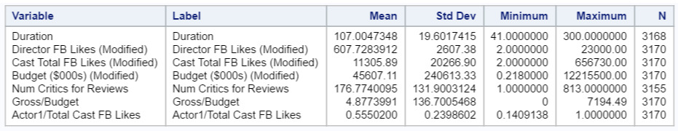
Descriptive Statistics: Dependent variables
Descriptive Statistics: independent numeric variables

Slide 33
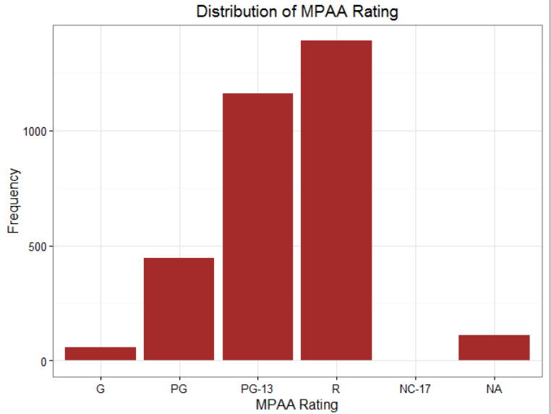
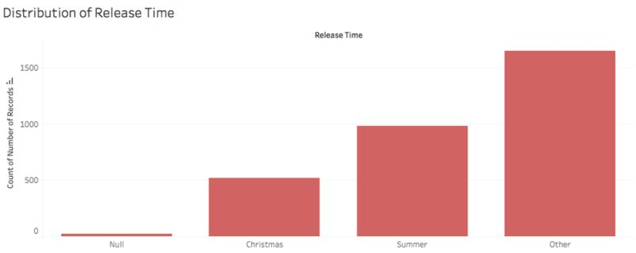
Descriptive Statistics: independent categorical variables

Slide 34
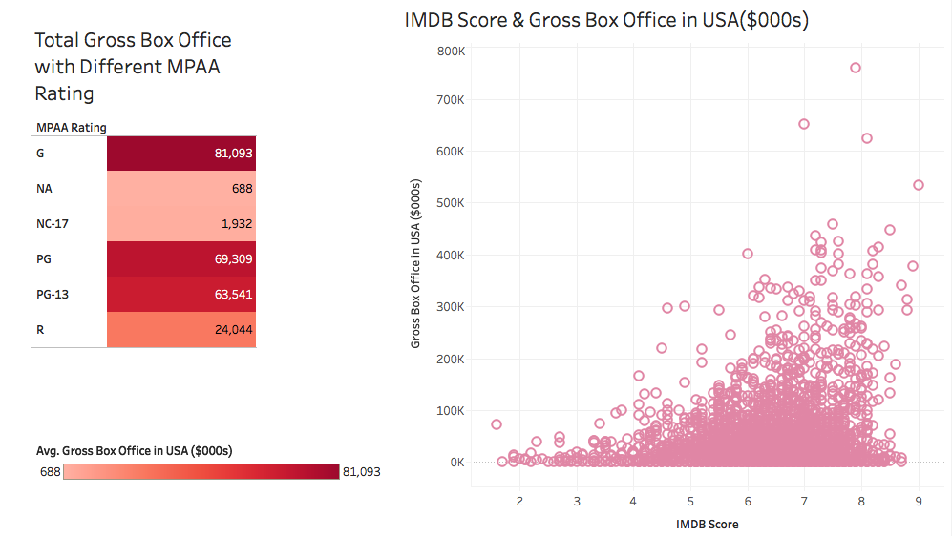
Gross box office & independent variables

Slide 35
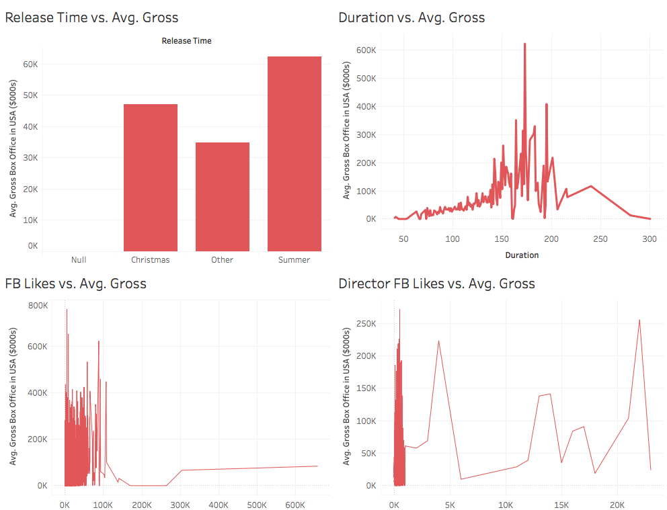
Gross box office & independent variables

Slide 36
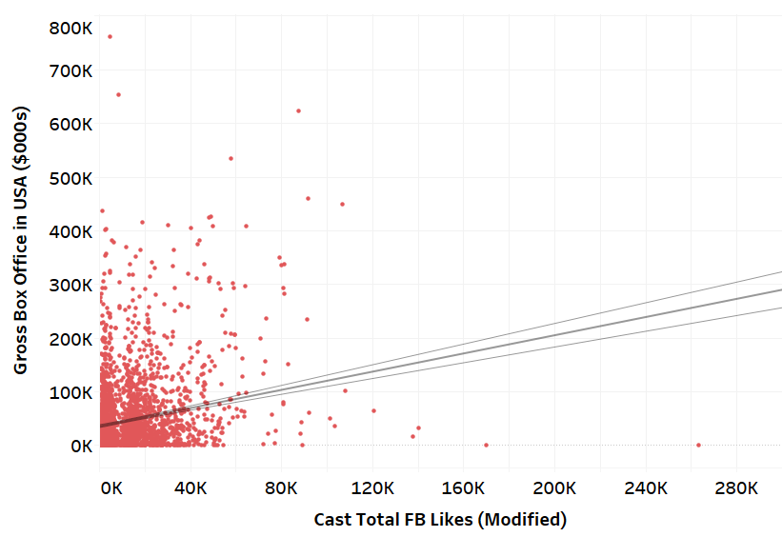
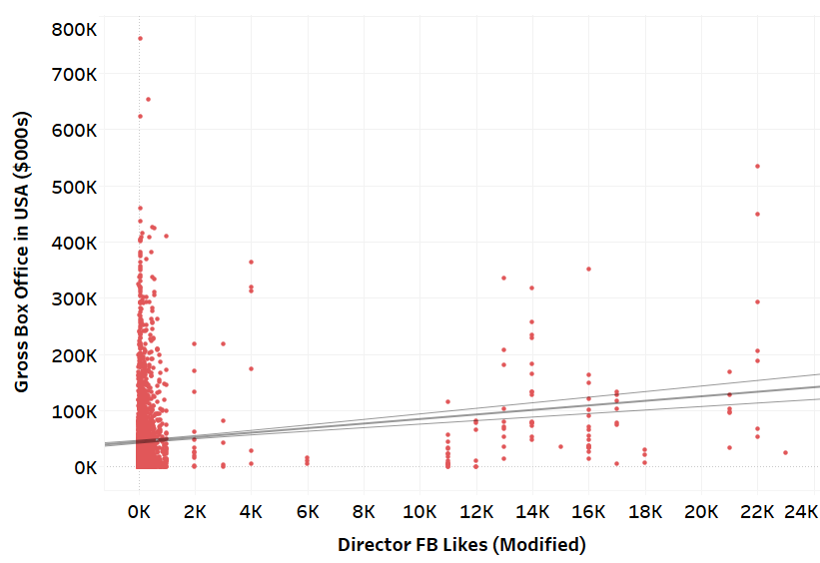
Gross box office & independent variables

Slide 37
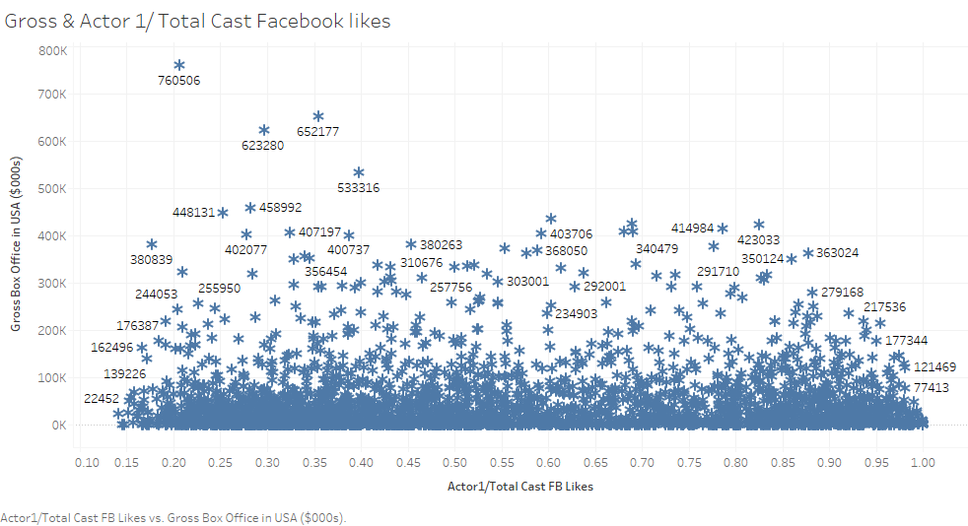
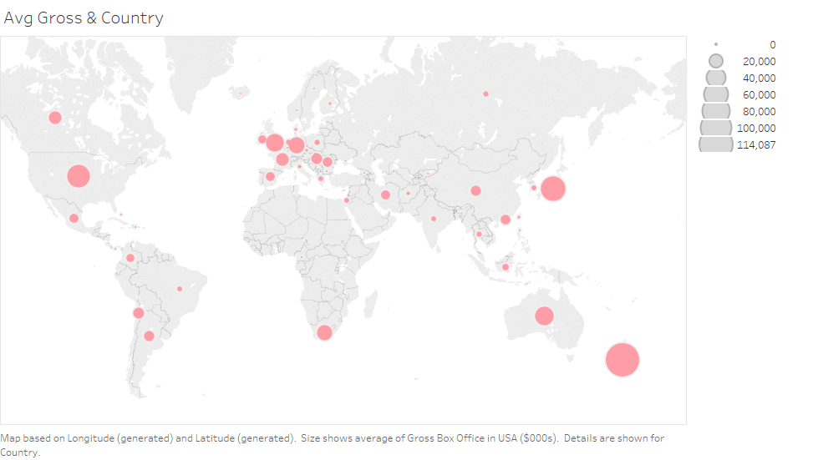
Gross box office & independent variables
Gross & Actor 1/Total Cast FB Likes
Avg. Gross & Country

Slide 38
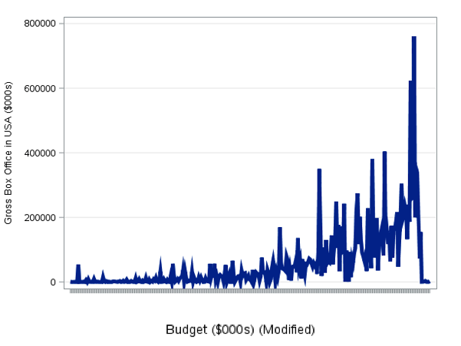
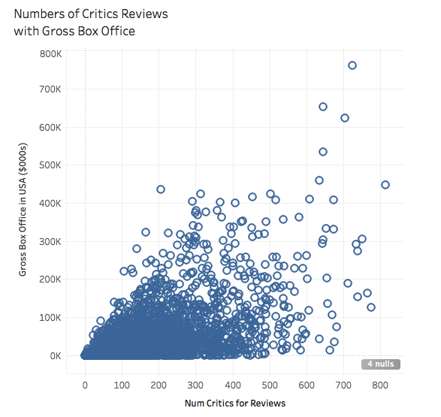
Gross box office & independent variables

Slide 39
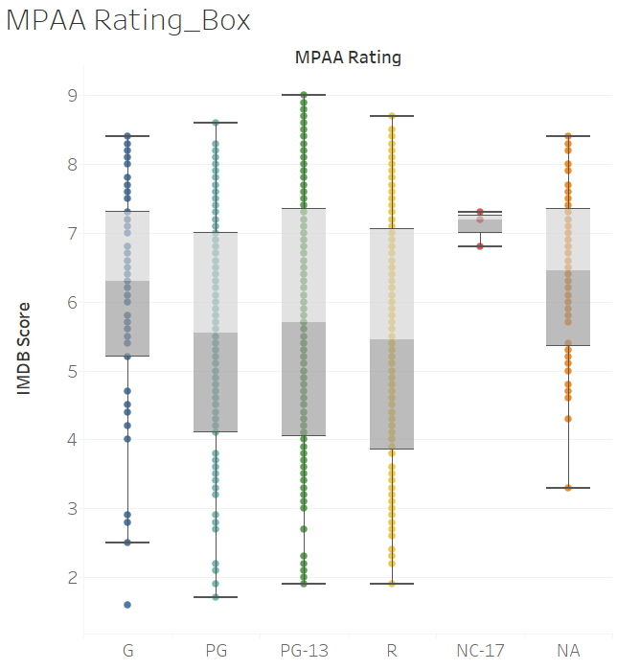
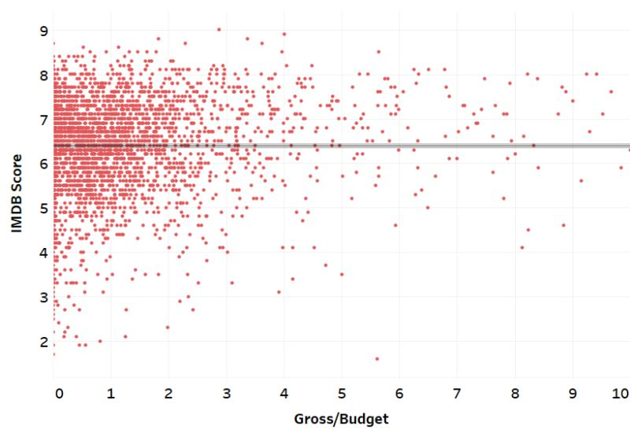
IMDB Scores & independent variables

Slide 40
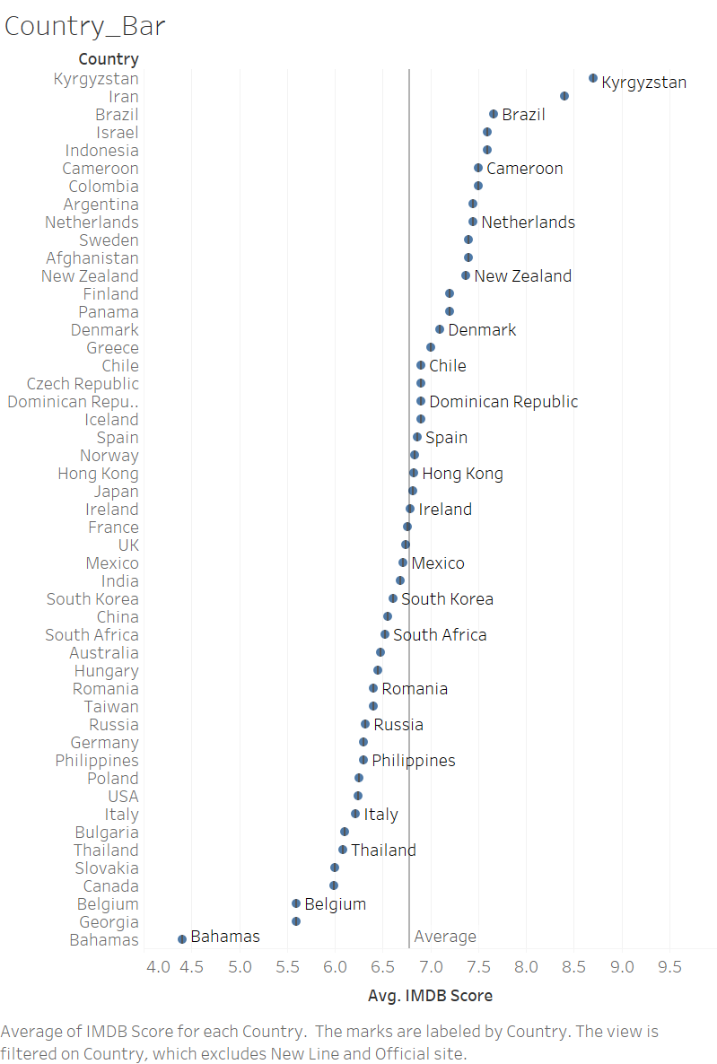
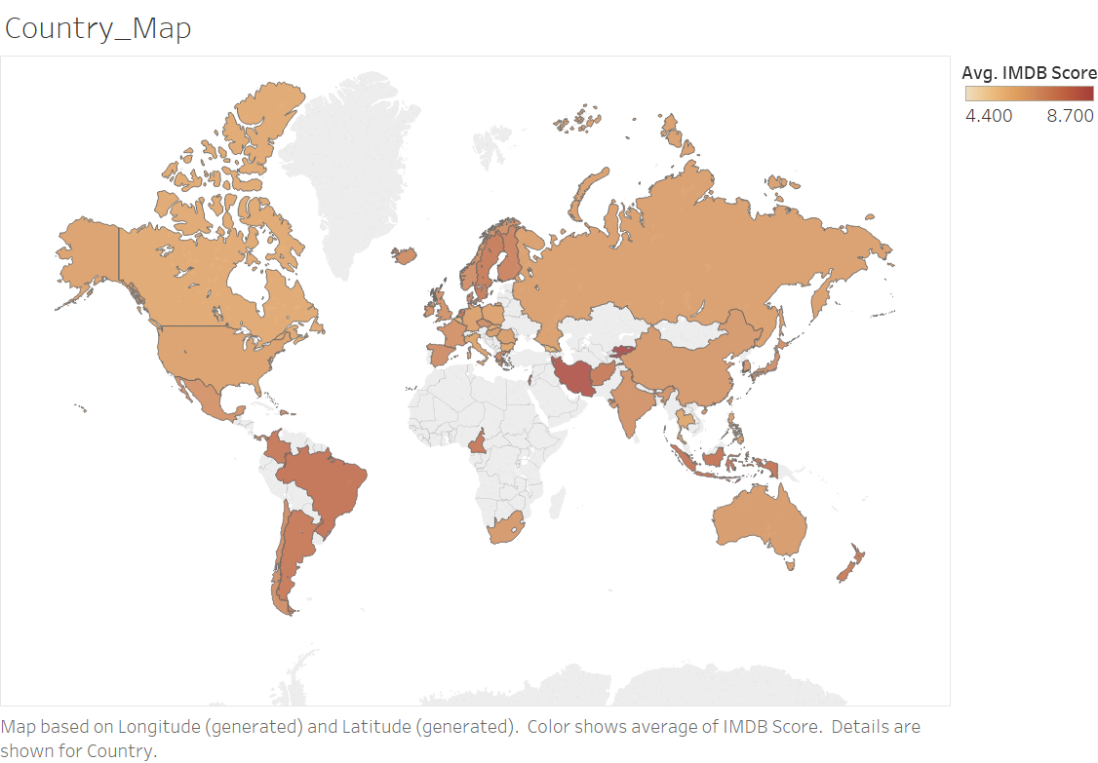
IMDB Scores & independent variables

Slide 41
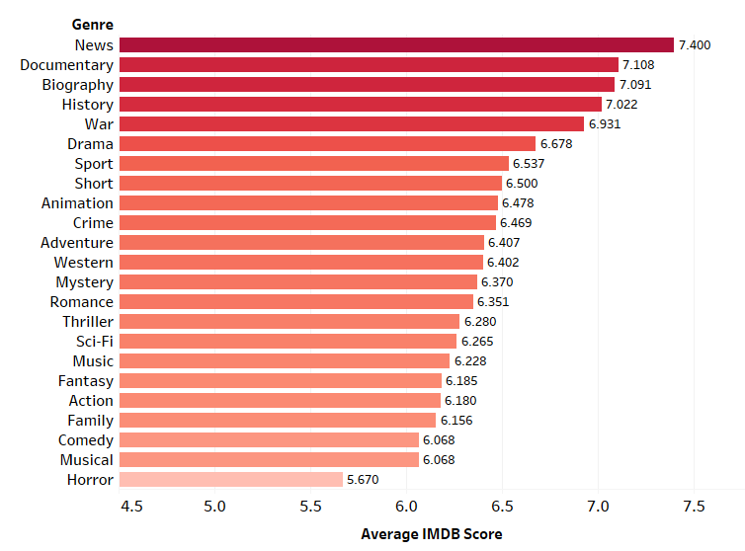
IMDB Scores & independent variables
Genre | IMDB Score | Number of Movie
News | 7.400 | 1
Documentary | 7.108 | 85
Biography | 7.091 | 204
History | 7.022 | 127
War | 6.931 | 124
Drama | 6.678 | 1609
Sport | 6.537 | 131
Short | 6.500 | 1
Animation | 6.478 | 185
Crime | 6.469 | 553
Adventure | 6.407 | 589
Western | 6.402 | 42
Mystery | 6.370 | 335
Romance | 6.351 | 697
Thriller | 6.280 | 904
Sci-Fi | 6.265 | 358
Music | 6.228 | 139
Fantasy | 6.185 | 386
Action | 6.180 | 735
Family | 6.156 | 382
Comedy | 6.068 | 1210
Musical | 6.068 | 65
Horror | 5.670 | 336

Slide 42
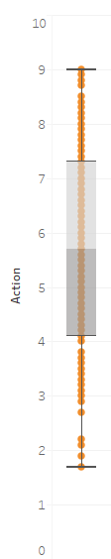
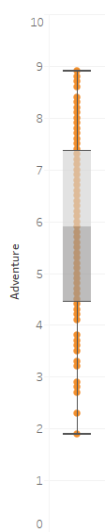
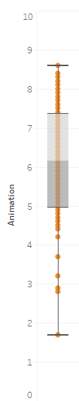
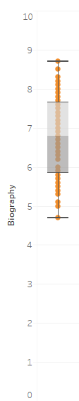
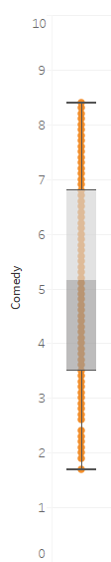
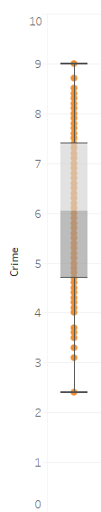
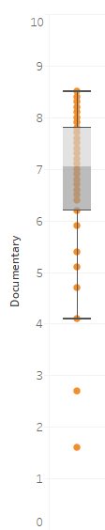
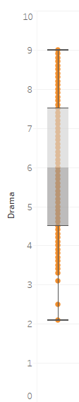
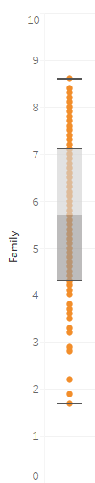
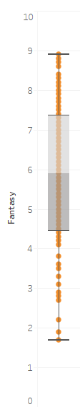
IMDB Scores & independent variables
Distribution of IMDB Score Based on Genre
Action Adventure Animation Biography Comedy Crime Documentary Drama Family Fantasy

Slide 43
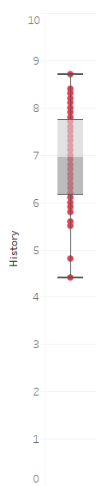
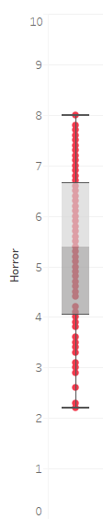
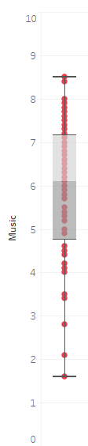
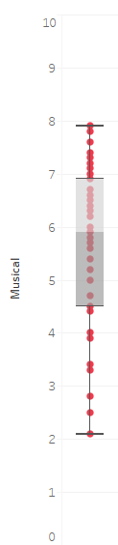
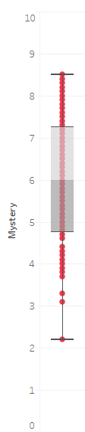





IMDB Scores & independent variables
Distribution of IMDB Score Based on Genre
History Horror Music Musical Mystery Romance Sci-Fi Sport Thriller War

Slide 44


IMDB Scores & independent variables

Slide 45
Interpretation, Action, and Feedback
Describe interpretation of the data analysis and modeling in the context of the business goal
Use Excel, SAS, Tableau to dig further into the relationship between gross box office/IMDB score and all the selected independent variables
Find the most relevant variables for producers/investors to make quality/revenue-related decisions
Analyze the best combinations of directors, film genres, actors, budget, etc. for producers to proceed a best-selling movie
Notes:
relationship (positive/ negative correlation, trend, etc.)

Slide 46
Interpretation, Action, and Feedback
Possible options and/or decisions available to the business based on the data analysis and modeling
For film producers/movie theaters, in order to produce/select a movie having high box office potential, it is recommended that they:
choose director and actors with higher Facebook likes/search interest
make movies in...genre/with...duration/etc. that attracts more audiences
consider the marginal effect of …(independent variable) on box office

Slide 47
Back up slides

Slide 48
ANOVA: Continent & IMDB Score
Continent | Continent | Estimate | Pr > |t|
North America | South America | -1.2715 | 0.0004
North America | Oceania | -0.4604 | 0.0049
Europe | South America | -0.8324 | 0.0213
Asia | South America | -0.7989 | 0.0336
Oceania | South America | -0.8111 | 0.0393
Asia | North America | 0.4726 | <.0001
Europe | North America | 0.4391 | <.0001
South America > Asia > Oceania > Europe > North America
Notes:
Differences of Continent Least Squares Means Adjustment for Multiple Comparisons: Tukey-Kramer

Slide 49
ANOVA: Genre & IMDB Score
Genre Category | Genre Category | Estimate | Pr > |t|
Action | Documentary | -0.7301 | <.0001
Documentary | Fantasy | 0.7645 | <.0001
Documentary | Happy Hour | 0.7599 | <.0001
Documentary | Tension | 0.7385 | <.0001
Documentary > Action > Tension > Happy Hour > Fantasy
Notes:
Differences of Genre Category Least Squares Means
Adjustment for Multiple Comparisons: Tukey-Kramer

Slide 50
ANOVA: MPAA Rating & IMDB Score
MPAA Rating | MPAA Rating | Estimate | Pr > |t|
PG | R | -0.2931 | <.0001
PG-13 | R | -0.1991 | <.0001
R > PG-13 > PG
Notes:
Differences of MPAA Rating Least Squares Means
Adjustment for Multiple Comparisons: Tukey-Kramer

Slide 51
ANOVA: Continent & Gross Box Office
Continent | Continent | Estimate | Pr > |t|
Asia | North America | -40571 | <.0001
Asia | Oceania | -44185 | 0.0005
Europe | North America | -27747 | <.0001
Europe | Oceania | -31361 | 0.0039
North America | South America | 45795 | 0.0474
Oceania > North America > Europe > Asia > South America
Model Pr > F: <.0001; R-Square = 0.0302
Notes:
Differences of Continent Least Squares Means Adjustment for Multiple Comparisons: Tukey-Kramer

Slide 52
ANOVA: Genre & Gross Box Office
Genre Category | Genre Category | Estimate | Pr > |t|
G | NC-17 | 79161 | 0.0448
G | R | 57049 | <.0001
PG | R | 45266 | <.0001
PG-13 | R | 39497 | <.0001
G > PG > PG-13 > R > NC-17
Model Pr > F: <.0001; R-Square = 0.1009

Slide 53
ANOVA: MPAA Rating, Genre & IMDB Score
Genre Category | MPAA Rating | Genre Category | MPAA Rating | Estimate | Pr > |t|
Action | PG | Documentary | PG | -0.6677 | 0.0001
Documentary | PG | Tension | PG | 0.867 | 0.0002
Fantasy | R | Happy Hour | R | -0.2212 | 0.0204
Fantasy | PG-13 | Happy Hour | PG-13 | 0.1753 | 0.0232
Fantasy | PG-13 | Tension | PG-13 | 0.1766 | 0.032
Fixed Rating
Fixed MPAA Rating:
PG: Documentary > Action > Tension
R: Happy Hour > Fantasy
PG-13: Tension> Happy Hour > Fantasy
Model Pr > F: <.0001; R-Square = 0.0471

